Slide 1
SolidWorks Sustainability

Slide 2
What is Sustainable Engineering?
Sustainable engineering is the integration of social, environmental, and economic conditions into a product or process
Soon all design will be Sustainable Design
SolidWorks Sustainability allows students to be environmentally conscious about their designs
Successful products are developed by integrating Life Cycle Assessment (LCA) directly into engineering design process
Notes:
Sustainable Engineering definition World Engineering Partnership for Sustainable Development (WEPSD, a partnership between WFEO, FIDIC and UATI)

Slide 3
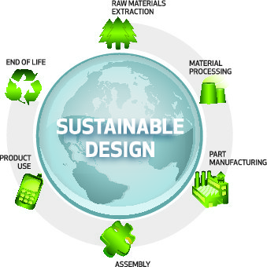
Life Cycle Assessment - LCA
A method to quantitatively assess the environmental impact of a product throughout its entire lifecycle, from the procurement of the raw materials, through the production, distribution, use, disposal and recycling of that product.
Notes:
A method to quantitatively assess the environmental impact of a product from the procurement of the raw materials, through the production, distribution, use, disposal and recycling of that product, these being the stages which constitute the product's lifecycle.
LCA is a process of evaluating the effects that a product has on the environment over the entire period of its life thereby increasing resource-use efficiency and decreasing liabilities. It can be used to study the environmental impact of either a product or the function the product is designed to perform and the transportation between stages. LCA is commonly referred to as a "cradle-to-grave" analysis.

Slide 4
LCA – Life Cycle Assessment
Raw Material Extraction
  Planting, growing, and harvesting of trees
  Mining of raw ore (example: bauxite)
  Drilling and pumping of oil
Material Processing - The processing of raw materials into engineered materials
  Oil into Plastic
  Iron into Steel
  Bauxite into Aluminum
Part Manufacturing - Processing of material into finished parts
  Injection molding
  Milling and Turning
  Casting
  Stamping
Assembly – Assemble all of the finished parts to create the final product
Product Use – End consumer uses product for intended lifespan of product
End of Life – Once the product reaches the end of its useful life, how is it disposed of
  Landfill
  Recycled
  Incinerated

Slide 5
Life Cycle Assessment Key Elements
Identify and quantify the environmental loads involved
  the energy and raw materials consumed
  the emissions and wastes generated
Evaluate the potential environmental impacts of these loads
Assess the options available for reducing these environmental impacts
Notes:
LCA's key elements are: (1) identify and quantify the environmental loads involved; e.g. the energy and raw materials consumed, the emissions and wastes generated; (2) evaluate the potential environmental impacts of these loads; and (3) assess the options available for reducing these environmental impacts.

Slide 6
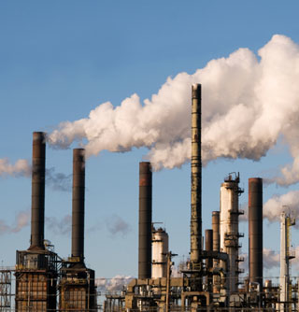

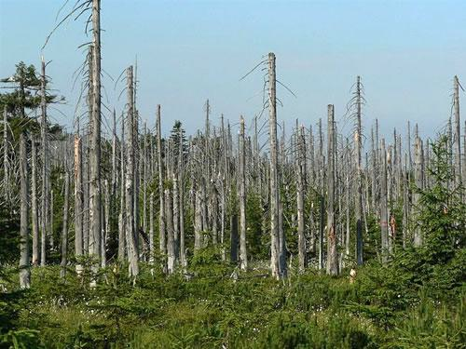
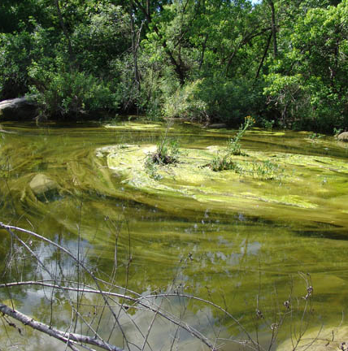
Environmental Impact Factors
Carbon Footprint
Total Energy
Air Acidification
Water Eutrophication
Notes:
There are 4 major environmental impact factors in the Life Cycle Assessment of a product Carbon Footprint, Total Energy Consumed, Air Acidification, and Water Eurtrophication

Slide 7
What is Carbon Footprint?
Carbon Dioxide CO₂ and other gasses which result from the burning of fossil fuels accumulate in the atmosphere which in turn increases the earth’s average temperature in kilograms (kg).
Carbon footprint acts as a proxy for the larger impact factor referred to as Global Warming Potential (GWP).
Global Warming is responsible for the loss of glaciers, extinction of species, more extreme weather, and other environmental problems.

Slide 8
What is Total Energy Consumed?
Measure of the non-renewable energy sources associated with the part’s lifecycle in mega joules (MJ). Impact includes:
  upstream energy required to obtain and process these fuels
  embodied energy of materials which would be released if burned
  electricity or fuels used during the product’s lifecycle
  Transportation?
Efficiencies in energy conversion (e.g. power, heat, steam) are taken into account.
Notes:
Non-renewable energy source examples coal, petroleum, and fossil fuel

Slide 9
What is Air Acidification?
Sulfur Dioxide SO₂, Nitrous Oxides NO_{x} and other acidic emissions to air that result in acid rain.
Makes the land and water toxic for plants and aquatic life.
Slowly dissolves manmade building materials such as concrete.
Measured in units of kilograms Sulfur Dioxide equivalent (SO₂e)
Notes:
cause an increase in the acidity of rainwater, which in turn acidifies lakes and soil.

Slide 10
What is Water Eutrophication?
Over abundance of nutrients added to a water ecosystem.
Nitrogen (N) and Phosphorous (PO₄) from waste water and agricultural fertilizers cause an overabundance of algae to bloom, which depletes the water of oxygen and results in the death of plant and animal life.
Measured in kilograms Phosphate equivalent (PO₄e).
Notes:
Also measured in terms of kilograms Nitrogen (N) equivalent

Slide 11
References
Underlying LCA Technology: PE International
  20 years of LCA experience
  LCA international database
  GaBi 4 - leading software application for product sustainability
  www.pe-international.com
International LCA Standards
  Environmental Management Life Cycle Assessment Principles and Framework ISO 14040/44 www.iso.org
US EPA LCA Resources
  http://www.epa.gov/nrmrl/lcaccess/
Goal & Scope
Interpretation
Inventory Analysis
Impact Assessment
LCA Framework ISO 14044
Notes:
The underlying technology used to perform the LCA is from PE International of Stuttgart Germany. They have extensive experience and credibility in this space for almost 20 years.
ISO – International Standards Organization.

Slide 12
Why SolidWorks Sustainability?
Soon all design will be Sustainable Design
More consumers want “greener” products
New and unfamiliar challenge for businesses
Sustainable design is a strategy for success
SolidWorks Sustainability
  Easy to use and to understand
  Reduces the environmental impact of product designs
  Communicates effectively through reports and graphic display
  SolidWorks SustainabilityXpress¹ is available to EVERY SolidWorks user at no cost
Notes:
A product's "greenness" is a factor that more and more consumers are paying attention to. As this influence grows in the market, many companies see this as a new and unfamiliar challenge to their business. Sustainable design is an important strategy that companies can use to reduce the environmental impact of the products they produce.
SolidWorks Sustainability has been created so that sustainable design becomes easy to understand and effortless to employ. Features such as its Dashboard, Customized Reports, and Find Similar Material allow users to easily improve their designs and communicate their accomplishments in a compelling way. This is seen as so important, that DS SolidWorks has included some of these sustainable design features in every seat of SolidWorks 2010.
¹SolidWorks 2009 or greater is required for the SolidWorks Labs version. SolidWorks Sustainability will be included in the SolidWorks Education Edition 2010-2011.

Slide 13
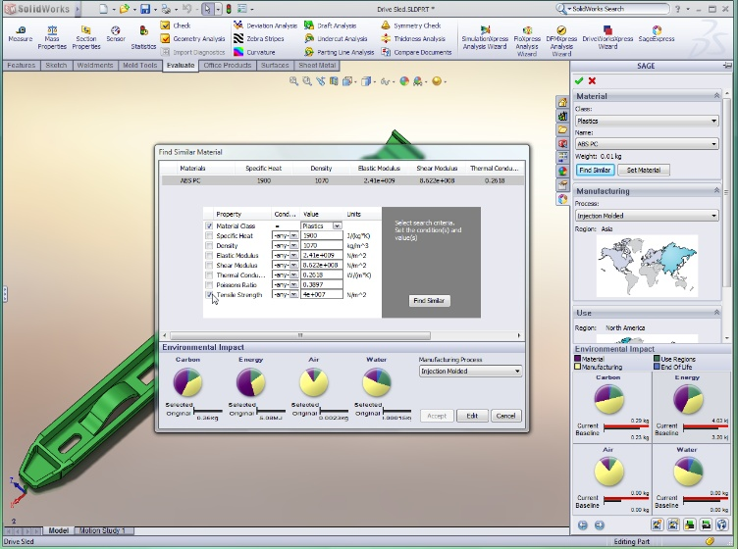
Why SolidWorks Sustainability in the classroom?
Available on SolidWorks Labs for SolidWorks 2009 http://labs.solidworks.com
Notes:
Students need to learn, understand, improve, and communicate the environmental impact of their design
Educators can provide insights on how choices in material and manufacturing processes affect the environment.
Instruction combines design and technology with the social, environmental, and economic conditions

Slide 14

SolidWorks Sustainability Methodology
Process
Set Baseline
Modify Inputs
Find Similar Materials
Modify Design
Input
Output
Material
Carbon
Dashboard
Manufacturing Process
Energy
Manufacturing Region
Air
Report
Transportation & Use
Water

Slide 15
Input Material Class and Material Name
Material Class and Name Hierarchy
Material Class |  | Material Name Material Class: Plastics
Steel | Plastics | ABS PC | Acrylonitrile Butadiene Styrene Polycarbonate
Iron | Other Metals | Acrylic
Aluminum Alloys | Other non-metals | Delrin® 2700 NC010 | Polyoxymethylene (POM, polyacetal or polyformaldehyde) mfg by Dupont
Copper Alloys | Generic Glass Fibers | Nylon 101
Titanium Alloys | Carbon Fibers | PE High Density | Polyethylene
Zinc Alloys | Silicons | PVC Rigid | Polyvinyl Chloride
Other Alloys | Woods | And many more

Slide 16
Input Manufacturing Process
Available manufacturing depends on material class
 | Class: Aluminum Alloys |  |  |  | Class: Plastics
Manufacturing Process | Die Casted | Sand Casted |  | Manufacturing Process | Injection Molded
 | Extrusion | Stamped/ Formed Sheet Metal |  |  | Extrusion
 | Forged | Machined Sand Casted
 | Milled | Turned

Slide 17
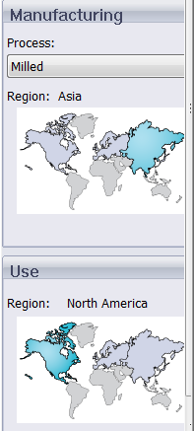
Input Manufacturing Region
Each region produces energy by different method combinations. Impact of a kWh is different for each region. Example methods include:
  Fossil Fuels
  Nuclear
  Hydro-electric
Determines the resources consumed by manufacturing processes in that region
Region Choices
  Asia
  Europe
  North America
  Japan

Slide 18
Input Transportation and Use Region
Determines the energy sources consumed during the product’s use phase (if applicable) and the destination for the product at its end-of-life.
  Asia
  Europe
  North America
  Japan
Estimates the environmental impacts associated with transporting the product from its manufacturing location to its use location.

Slide 19
SolidWorks Calculates Environmental Impact
Parameters
  Carbon Footprint
  Air Acidification
  Water Eutrophication
  Energy Consumed
Factor Percentage
  Material
  Manufacturing
  Use Regions
  End of Life
Set Baseline

Slide 20
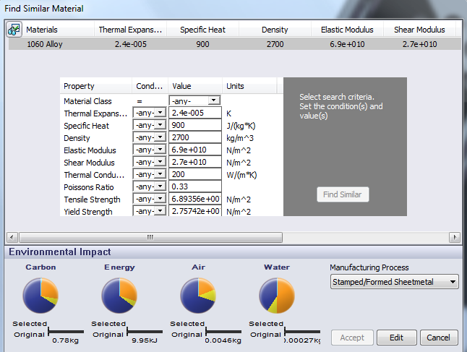
Find Similar Materials based on Material Properties
Thermal Expansion
Specific Heat
Density
Elastic Modulus
Shear Modulus
Thermal Conductivity
Poisson’s Ratio
Tensile Strength
Yield Strength

Slide 21
Definitions of Material Properties
Thermal Expansion - the change in length per unit length per one degree change in temperature (change in normal strain per unit temperature) (K)
Specific Heat - quantity of heat needed to raise the temperature of a unit mass of the material by one degree of temperature. (J/kg K)
Density - Mass per unit volume. (kg/m³ )
Elastic Modulus (Young’s Modulus) - ratio between the stress and the associated strain in a specified direction (N/m²)
Shear Modulus (Modulus of Rigidity) - the ratio between the shearing stress in a plane divided by the associated shearing strain (N/m²)
Thermal Conductivity - rate of heat transfer through a unit thickness of the material per unit temperature difference. (W/m K)
Poisson’s Ratio - ratio between the contraction (traverse strain), normal to the applied load to the extension (axial strain), in the direction of the applied load. Poisson’s ratio is a dimensionless quantity.
Tensile Strength –the maximum amount of tensile stress that a material can be subjected to before failure (N/m²)
Yield Strength – Stress at which the material becomes permanently deformed (N/m²)
Notes:
Hone ex

Slide 22
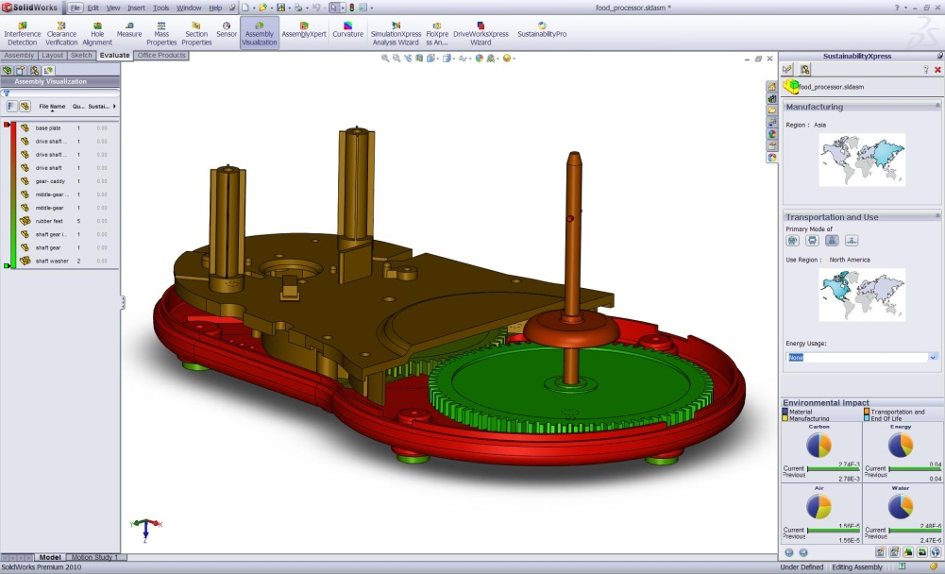
SolidWorks Sustainability
Same functions as SustainabilityXpress
LCA of assemblies
Configuration support
  Save inputs and results per configuration
Expanded reporting capabilities for assemblies
Specify amount & type of energy consumed during use
Specify method of transportation
Support for Assembly Visualization

Slide 23
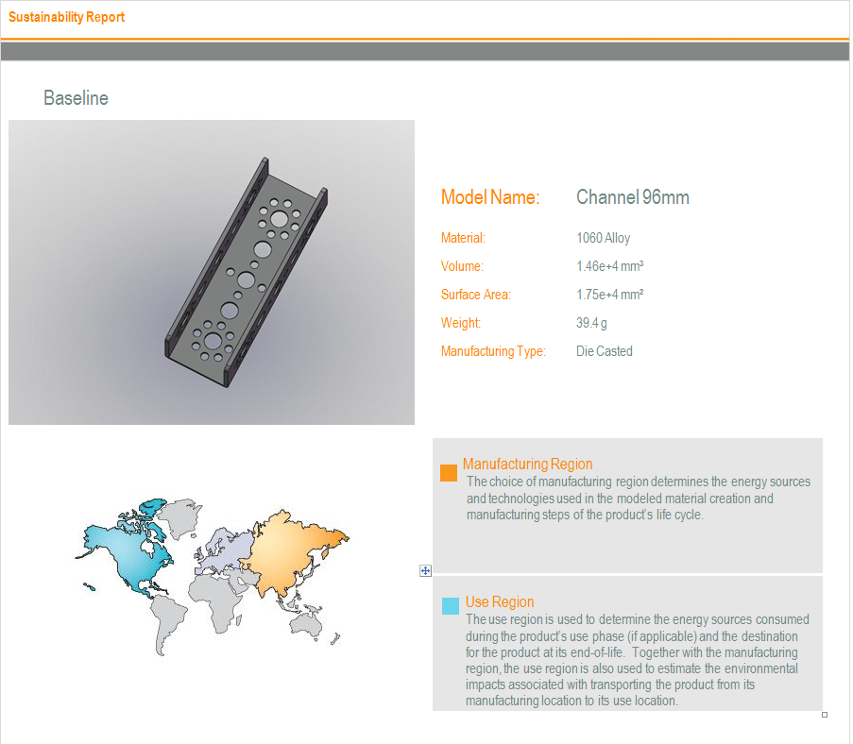
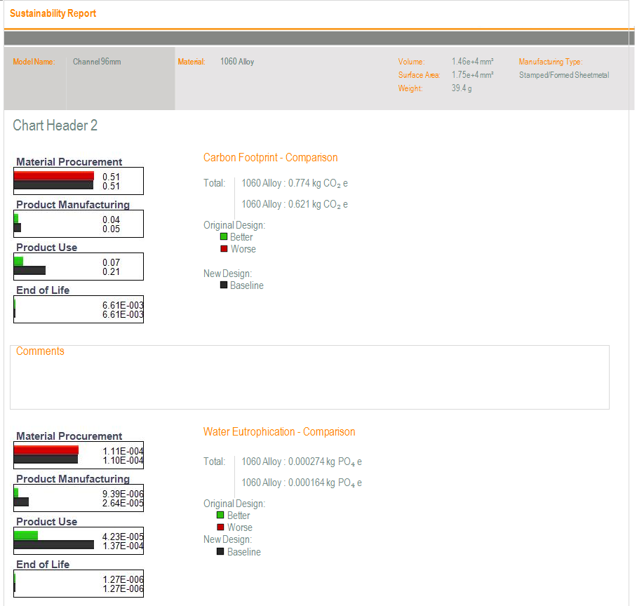
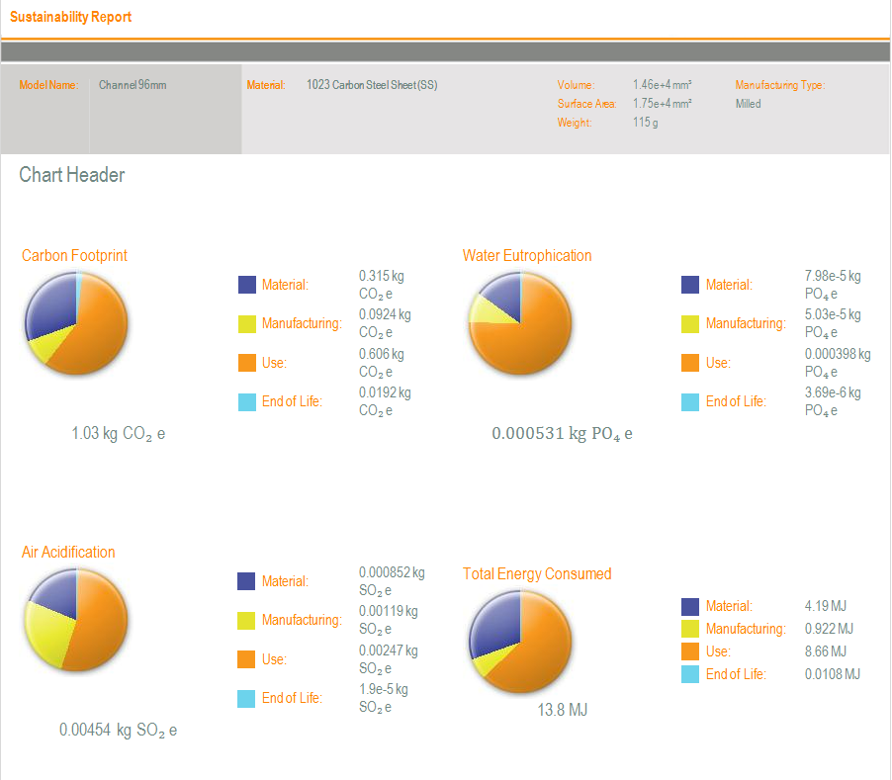
Sustainable Report

Slide 24
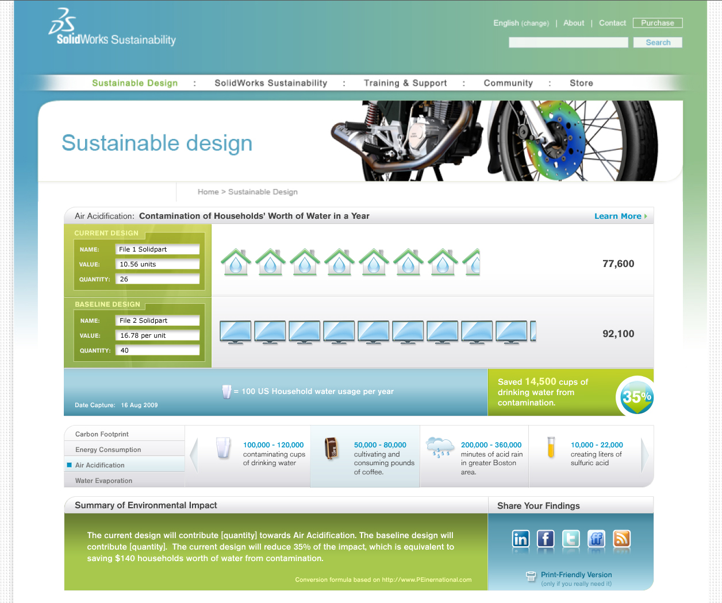
SolidWorks Sustainability - Online Calculator
Converts environmental impacts into human scale parameters
Example: Carbon Footprint converted into miles driven in a car

Slide 25
Why SolidWorks Sustainability in the classroom?
Students need to learn, understand, improve, and communicate the environmental impact of their design
Educators can provide insights on how choices in material and manufacturing processes affect the environment.
Instruction combines design and technology with the social, environmental, and economic conditions

Slide 26
Thank you

